Slide 1

2020-21 3-2 Alternative stable states, phase shifts and catastrophic transitions. Chaos and unpredictability Alternative stable states in Coral Reefs
Vincent Jansen
vincent.jansen@rhul.ac.uk

Slide 2
Outline
3-1 Phase Shifts and Catastrophic Transitions
3-2 Alternative Stable States in Coral Reefs
3-3 Evidence for Alternative Stable States
3-4 Chaos and unpredictability

Slide 3
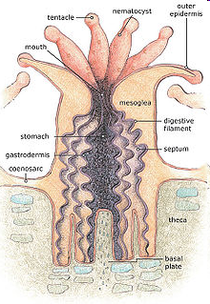
Coral Reefs
Coral reefs are made out of colonies of “polyps”. Reef building corals belong to the phylum Cnidaria
Occur in nutrient poor waters
They have tentacles to capture prey
Polyps secrete calcium carbonate, that accumulate and forms the reef
Reproduction mainly asexual through budding
Notes:
Cnidaria (jellyfish, anemones, hydroids).

Slide 4
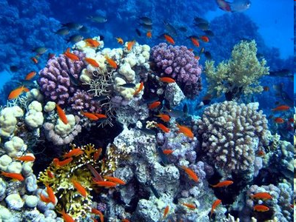
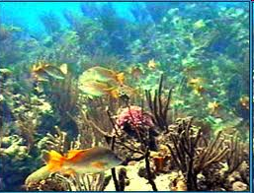
Coral Reefs
Coral reefs are highly diverse both in terms of corals as in other marine animals

Slide 5
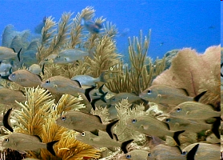
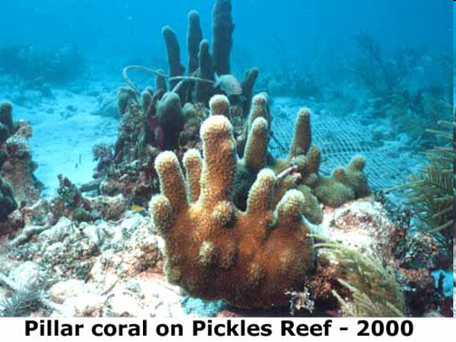
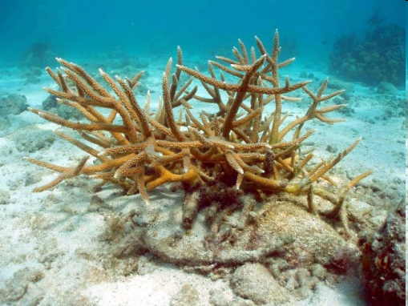
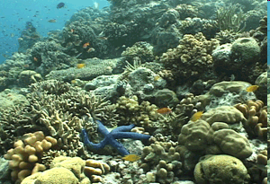
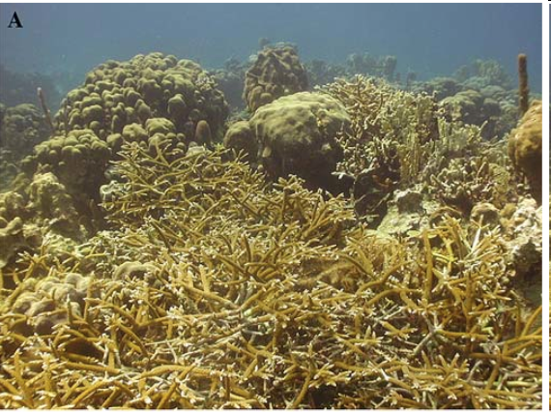
Notes:
Stag horn (bottom lef) pillar coral (top right)

Slide 6
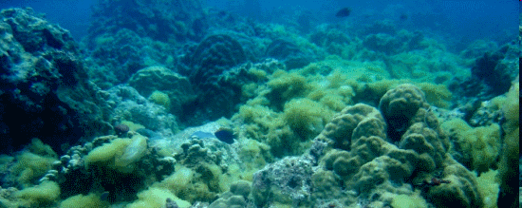
Coral Reefs
Corals compete for space with algae and macroalgae
If space opens up all players will try to fill it
Macroalgae can overgrow a coral, coral can invade algal turfs

Slide 7
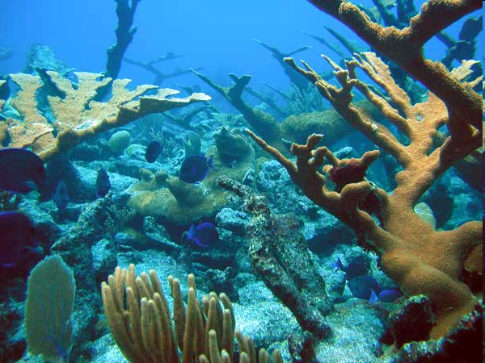
Blue tangs swimming in an elkhorn coral forest

Slide 8
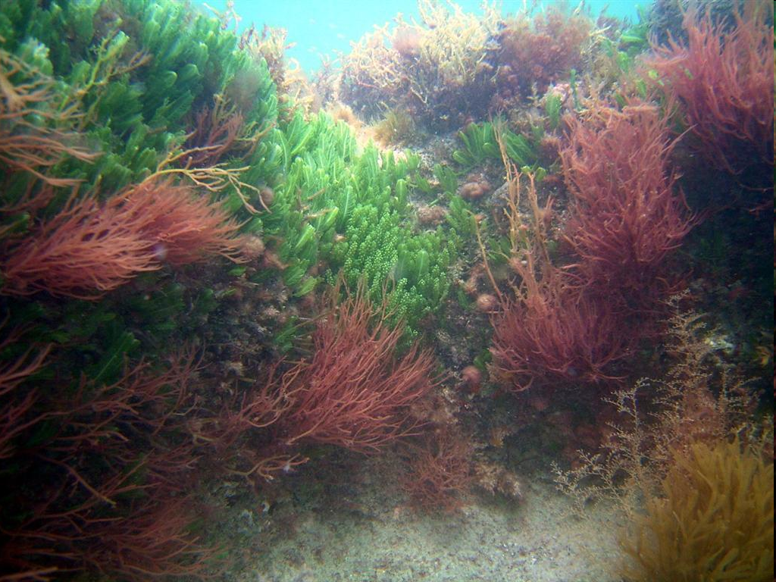
Coral overgrown with macroalgae

Slide 9
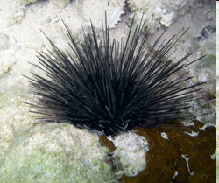
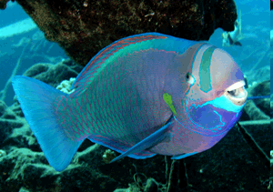
Coral reefs
Even though algae can overgrow coral, this normally is prevented through herbivores, who feed on the macroalgae
Diadema antillarum
(long spined sea urchin)
Parrot fish

Slide 10
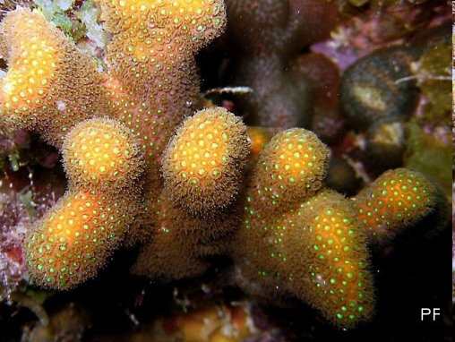
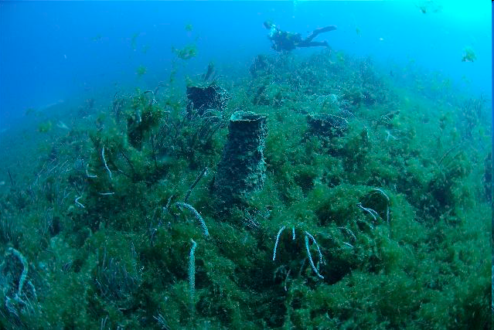
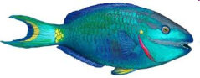
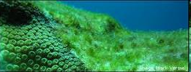
Simplified Coral Reef Ecology
Overgrowing
macroalgae
coral
Vegetative
spread
Colonisation dead coral
Overgrowing
Grazing
algal turf
herbivores

Slide 11
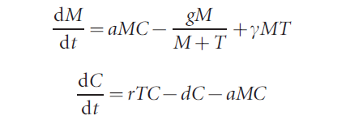
The same information, put in a model
with T+M+C=1
M, C and T describe the amount of space covered by Macroalgae, algal Turf and Coral
From: Mumby et al. Nature (2007)

Slide 12
Isoclines for the coral reef model
C
M
In the model, changing the amount of grazing, which determines the death rate of the macroalgae, is much the same as reducing the carrying capacity of the macroalgae.

Slide 13
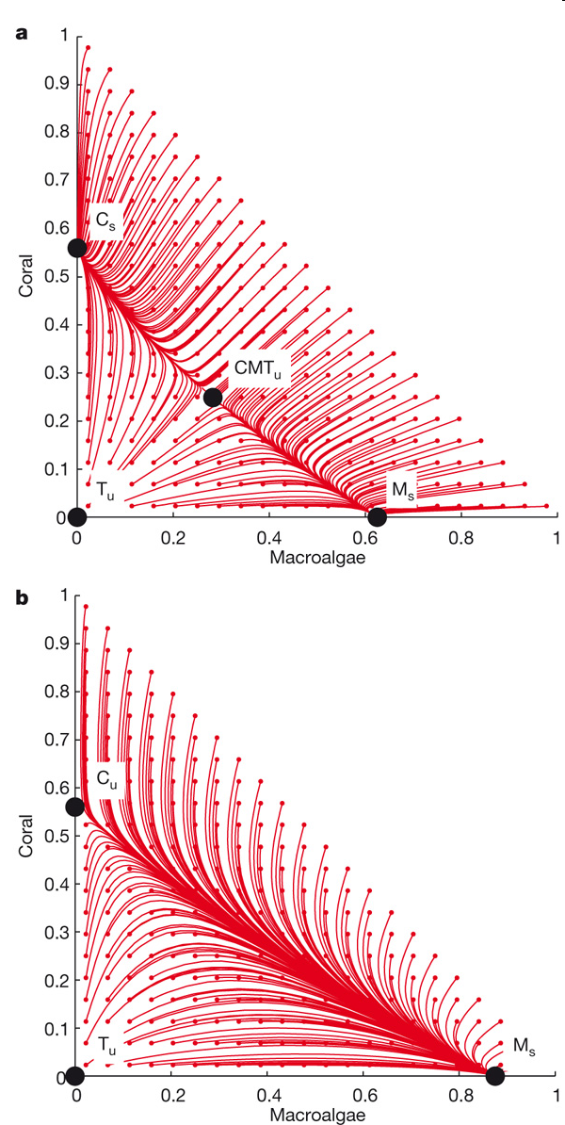

Slide 15
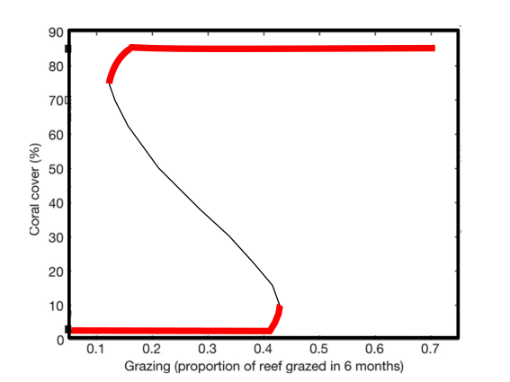
Bifurcation diagram for the Mumby model

Slide 16
Carribenan Coral Reefs
In the early 1980’s Caribbean reefs experienced a sudden shift from coral dominated reefs to reefs with substantial macroalgae populations
This followed a time of chronic fishing of herbivores, hurricane damage and a die-off of Diadema antillarum in 1983

Slide 17
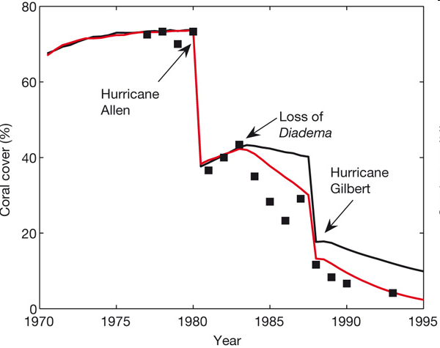
Coral cover in Jamaican reefs
Predictions are denoted by lines and empirical data are denoted by black squares
Notes:
Predictions are denoted by lines and empirical data are denoted by black squares. The model that was run with a median algal–coral overgrowth rate of 8 cm2 yr-1 is shown with a black line and the upper rate of 14 cm2 yr-1 is shown with a red line. 1983 Massive disease induced mortality in the sea urchins

Slide 18
Data explained using alternative stable states
Notes:
Stable and unstable equilibria are denoted by solid and open squares, respectively. Black denotes 8 cm2 yr-1, red denotes 14 cm2 yr-1. Blue lines, marked with appropriate dates, represent model predictions of the trajectory of reefs in Jamaica (see also Fig. 1).

Slide 19
Data explained using alternative stable states
Grazing Carrying capacity k₁
Notes:
Stable and unstable equilibria are denoted by solid and open squares, respectively. Black denotes 8 cm2 yr-1, red denotes 14 cm2 yr-1. Blue lines, marked with appropriate dates, represent model predictions of the trajectory of reefs in Jamaica (see also Fig. 1).

Slide 20
Alternative Stable States, Catastrophic transition
N₂
N₁ or N₂
N₂
N₁
k₂/β
k₂α
k₁

Slide 21
Data explained using alternative stable states
Notes:
Stable and unstable equilibria are denoted by solid and open squares, respectively. Black denotes 8 cm2 yr-1, red denotes 14 cm2 yr-1. Blue lines, marked with appropriate dates, represent model predictions of the trajectory of reefs in Jamaica (see also Fig. 1).

Slide 22
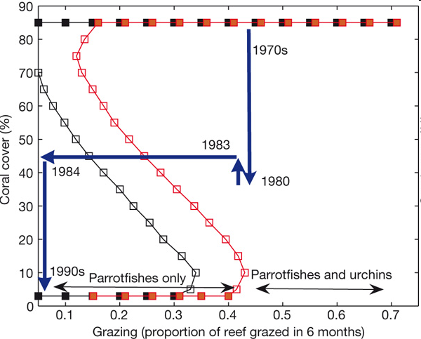
Data explained using alternative stable states
Notes:
Stable and unstable equilibria are denoted by solid and open squares, respectively. Black denotes 8 cm2 yr-1, red denotes 14 cm2 yr-1. Blue lines, marked with appropriate dates, represent model predictions of the trajectory of reefs in Jamaica (see also Fig. 1).

Slide 23
Coral cover in Jamaican reefs
Predictions are denoted by lines and empirical data are denoted by black squares
Notes:
Predictions are denoted by lines and empirical data are denoted by black squares. The model that was run with a median algal–coral overgrowth rate of 8 cm2 yr-1 is shown with a black line and the upper rate of 14 cm2 yr-1 is shown with a red line. 1983 Massive disease induced mortality in the sea urchins

Slide 24
Coral reef recovery
Reef coverage declined following a time of chronic fishing of herbivores, hurricane damage and a die-off of Diadema antillarum in 1983
Although Diadema beginning to return in some places, reef recovery is patchy and many reefs still have not recovered to previous levels of coverage

Slide 25
Catastrophic transitions: management implications
If coral reefs, or other ecosystems have alternative stable states, this has important management implications.
In general, prevent large perturbations and manage so that the basin of attraction of the desirable state is largest
For instance, through limiting overfishing of herbivores

Slide 26
Evidence
Although a compelling story, it is not universally accepted that the decline of coral reefs is caused by alternative stable states.
One of the problems that it is hard to show in a real ecosystem that there are multiple stable states
See See Mumby et al. Oikos (2013), also Dudgeon et al. MEPS (2011)

Slide 27
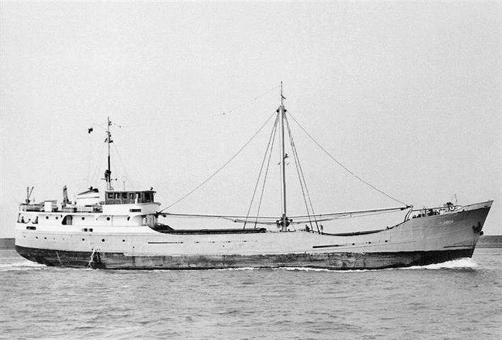
The wreck of the MV Florida
In June 1976 the MV Florida, on a voyage to Townsville, Queensland, carrying a cargo of pozzalin, ran ashore at Myrmidon Reef. The ship broke in two and spilled its cargo

Slide 28
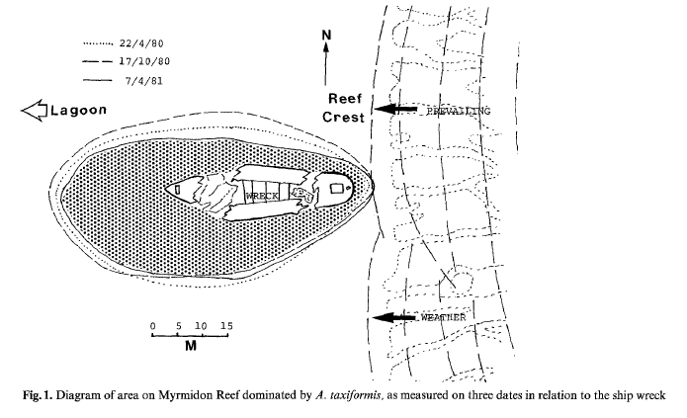
The pozzalin washed away. But five years later macroalgae still dominated the area where the cargo had been spilled.
Evidence or anecdote?
Macroalgae dominated
Coral dominated
From: Hatcher Coral Reefs 3, 4 (1984): 199-204.

Slide 29
Evidence
In general, it is difficult to show this conclusively, as:
Catastrophic shifts are rare events
Statistic methodology underdeveloped
To demonstrate alternative stable states one needs:
Repeated shifts
To show it is plausible that there are alternative stable states (fit data using models)

Slide 30
Learning outcomes
Understand how a change in carrying capacity can bring about a qualitative change
the difference between a phase transition and catastrophic transition
Understand the importance of transitions for ecosystems, management and conservation

